Slide 1
Using Lung ultrasound images for building a reliable Point-of-care Covid-19 testing system
Sanket Sanjay Bhosle – 0776136
Mandeep Kaur – 0779091
Simranjeet Singh - 0783612
Anjaliraj Baburaj - 0781499
Rishika Shivani Adulla -0784455
Section – 003
Group – 10

Slide 2
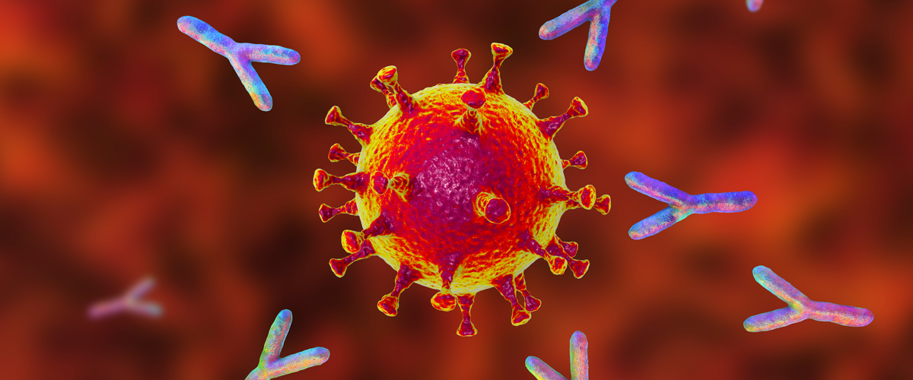

Introduction
Coronavirus disease is an infectious disease caused by SARS-CoV-2 virus.
Image Source : https://healthmatters.nyp.org/covid-19-vaccines-and-immunity/
Image Source : https://together.stjude.org/en-us/care-support/covid-19-resources/social-distancing.html
Notes:
Coronavirus disease is an infectious disease caused by SARS-CoV-2 virus. Most people infected with the virus experience mild to moderate respiratory illness and are able to recover without requiring any special treatment. But, some do require serious medical attention.
A person infected with coronavirus even if they show no symptoms may emit aerosols while talking or breathing. Aerosols are defined as infectious viral particles that can float around in the air for up to three hours. Another person breathing in these aerosols can become infected with the coronavirus (Harvard Medical School, 2022). Isolating infected patients and testing people they met are the primary steps taken after Covid-19 diagnosis.

Slide 3
Introduction
COVID-19 Testing Systems and their inefficiencies
Rapid tests :- Antigen tests, self-testing kits
Laboratory tests :- Reverse Transcription-Polymerase Chain Reaction (RT-PCR)
Laboratory processing that takes 1-3 days to return the results.
Backlogs and supply shortages.
Quick results but they are not as reliable as laboratory tests.
False Positives are rare but False Negatives are very frequent. (Yetman, 2022).

Slide 4
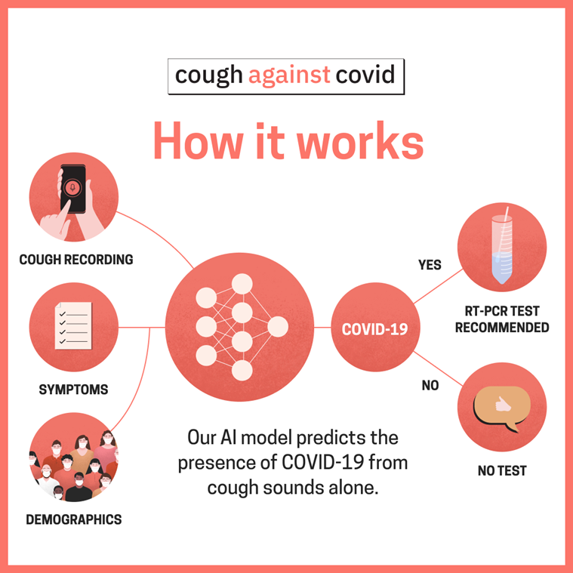
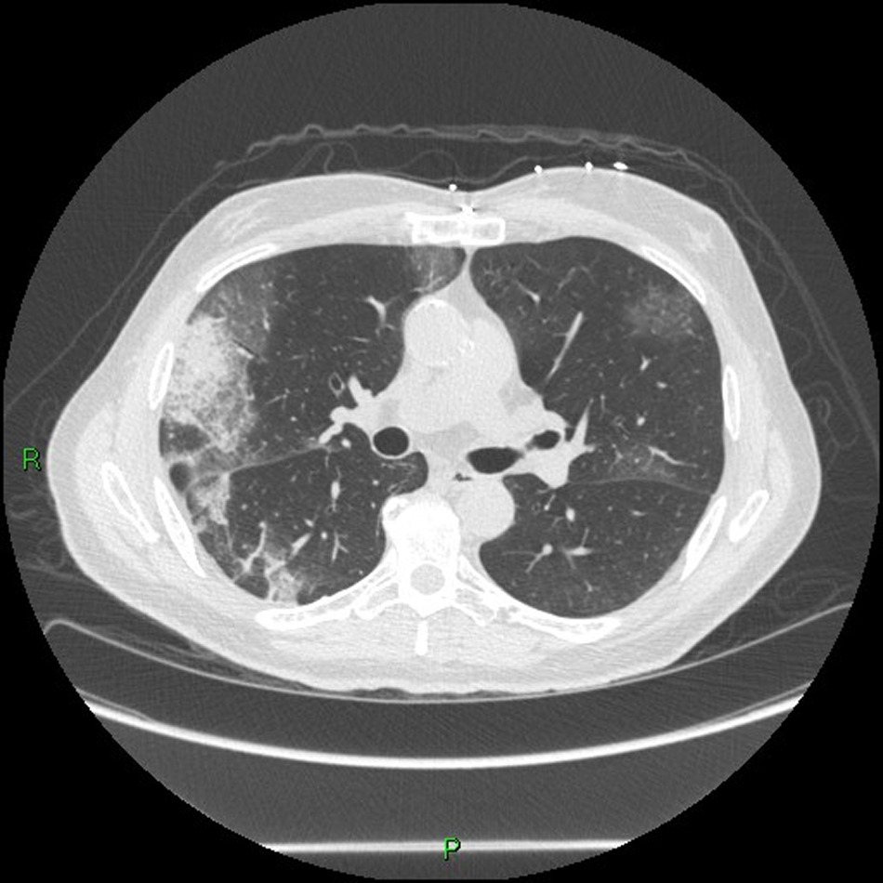
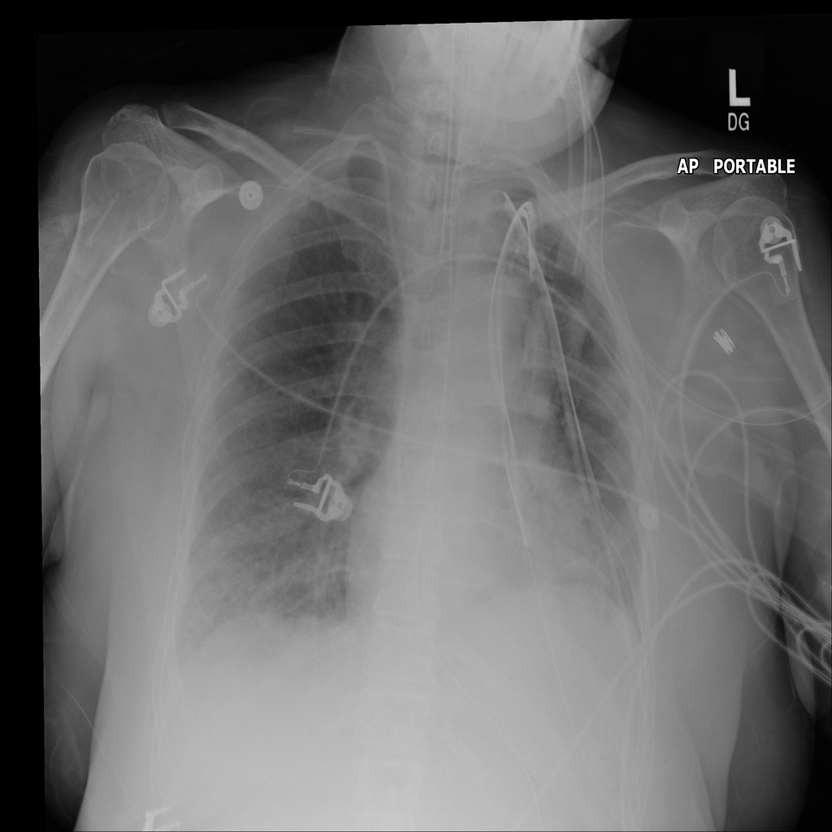
Literature Review
Covid detection using cough recordings
CT-SCAN
Chest X-ray
Notes:
1. No consideration in differences in cough due to age and cultural/regional differences.
Unsafe testing method.
2. COVID-19 detection and diagnosis using chest X-ray and CT- Scan images using deep learning algorithms . CT scan images have too many cross sections of the same person.
Models fail to incorporate manual/ground truths with the images.
3. Combination of machine learning and radiomics for diagnosing coronavirus using chest X-ray images in presence of other diseases and at different severity levels. Time consuming method.
Sensitivity drops with increase in severity level.

Slide 5
Research Questions
Which machine learning classification algorithm works the best for diagnosing Covid-19 using lung ultrasound images evaluated using accuracy, precision, recall and F1-Score ?
Which technique helps the most in achieving the success criteria by optimizing model performance ?

Slide 6
Data Description
COVIDx-US is an open access benchmark dataset of ultrasound imaging related to COVID-19.
The dataset has been curated from 8 sources.
192 lung ultrasound videos and 18,628 lung ultrasound images have been extracted.
The videos have been captured with one of the two probes – Convex or Linear.
Probe Type | No. of images
Convex | 14239
Linear | 4389

Slide 7
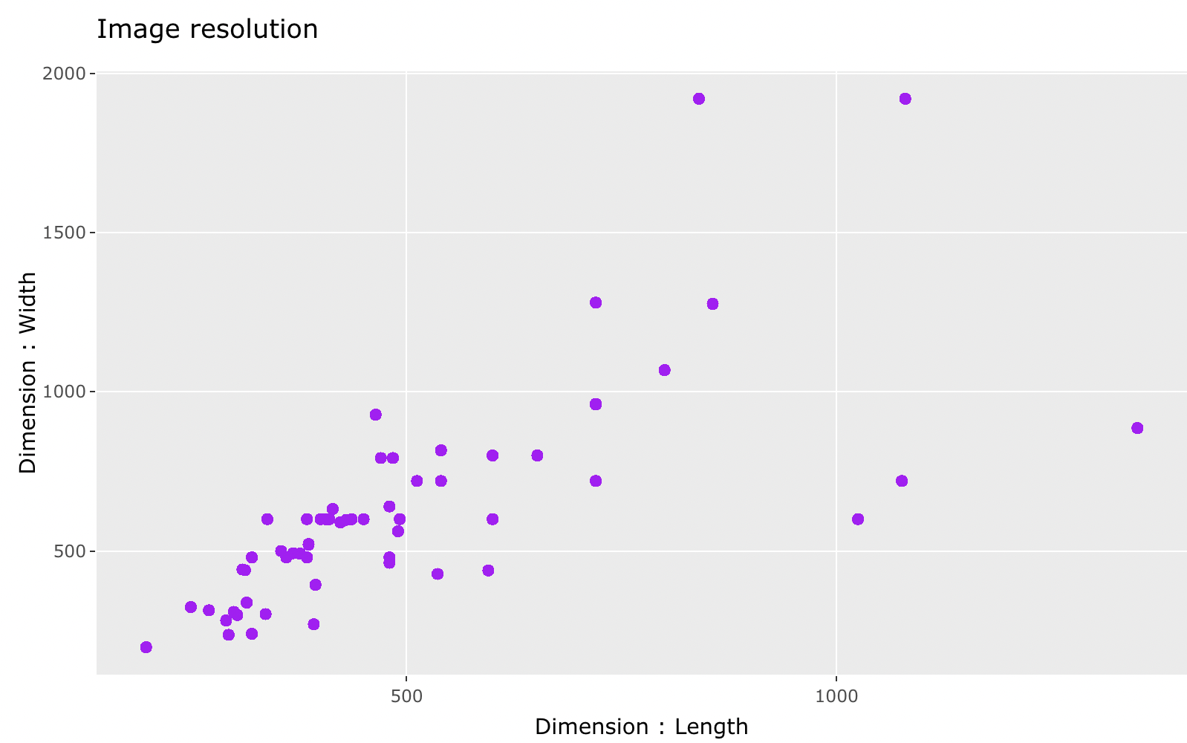
Data Description
-> There are lung ultrasound images belonging to four classes – Covid, Normal, Pneumonia, Other
-> The width of the images range from 198 to 1920 pixels.
-> The length of images range from 197 to 1350 pixels.
Class | Number of Images
COVID | 4003
Normal | 2201
Pneumonia | 4449
Other | 7975

Slide 8
Methods of Analysis
The following pre-processing steps have been performed :-
Total Images - 18,628
Removed duplicate images
Image count - 15,798
Pixel Normalization
Images stored in RGB mode
Image Resizing to length of 197 pixels and width of 198 pixels
Validation images - 1384
Dataset split up into three parts
Training images - 9691
Test images - 2771

Slide 9
Results
Model | Technique | Accuracy | Precision | Recall | F1-Score
VGG-16 (Baseline) |  | 55% | 66% | 67% | 66%
VGG-19 | Offline Data Augmentation | 78.40% | 76% | 98% | 86%
Support Vector Machine | Near Miss Undersampling | 86.50% | 90% | 84% | 85%
Random Forest Classifier | SMOTE | 89.02% | 92% | 86% | 88%
Logistic Regression |  | 84.37% | 89% | 83% | 83%
ResNet50V2 | Balanced Class Weights | 93.17% | 99% | 90% | 94%
Binary Classification
These models have been used for classifying lung ultrasound images into COVID and Non-COVID classes :-

Slide 10
Results
The chart above shows the prediction accuracy returned by the models on the test dataset.

Slide 11
Results
The plot represents the percentage of correctly identified cases for both categories for each model.

Slide 12
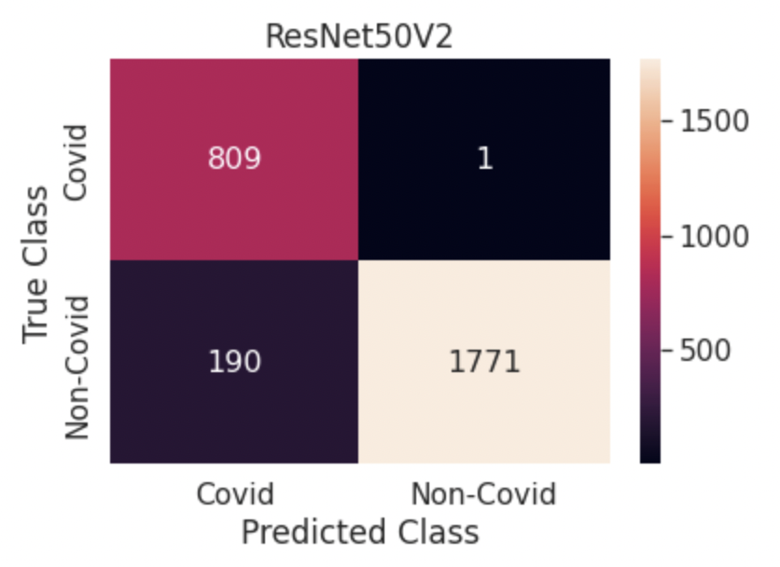
Results
ResNet50V2 outperformed all other models as per all the performance metrics :-
Accuracy – The model correctly identifies 93% of the total images in the test dataset.
Precision – When the model classifies an image as of COVID class, it is correct 99% of the time
Recall – Of all the COVID positive patients, the model can correctly identify 90% of them.
F1-Score – The harmonic mean of precision and recall is 94%.

Slide 13
Results
Four Class Classification
Model | Technique | Accuracy | Precision | Recall | F1-Score
ResNet50V2 | Balanced class weights | 87.8% | 89% | 87% | 85.6%
Xception | Balanced class weights | 96.90% | 93% | 99% | 97%
Decision Tree Classifier | Balanced Bagging Classifier | 95.37% | 95% | 93% | 96%
Multinomial Logistic Regression | Stratification | 94.42% | 96% | 96% | 96%

Slide 14
Results
-> It must be noted that Xception model has given the highest prediction accuracy among all.
-> The chart draws a comparison between precision and recall values for the models.

Slide 15
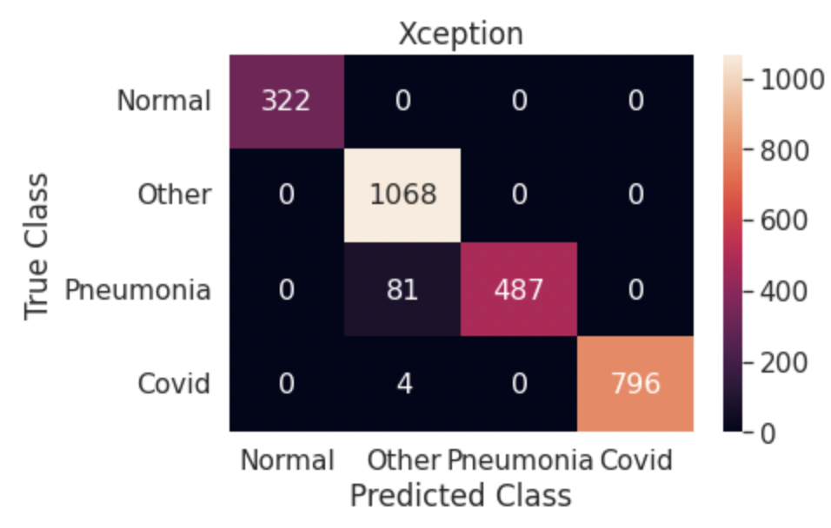
Results
Performance of the best model – Xception on every image class :-

Slide 16
Conclusions
Convolutional neural networks in combination with Image data generators and transfer learning has the capability of being an alternative approach for COVID-19 testing.
Deep learning architectures like ResNet50V2 and Xception along with algorithms like Support Vector Machine, Random Forest Classifier and Balanced Bagging Classifier are applicable.
Using balanced weights for each class, stratified sampling and data augmentation are some of the techniques which can make the models robust and unbiased towards all classes.

Slide 17
Future Work
Research
The ‘Other’ category can be researched to understand the kind of cases contained in this class.
Enhance
Collection of more lung ultrasound for enhancing classification model’s performance.
Validate
Validating model performance with RT-PCR results.
Expand
Scope expansion by including more cases other than COVID, Normal and Pneumonia.

Slide 18
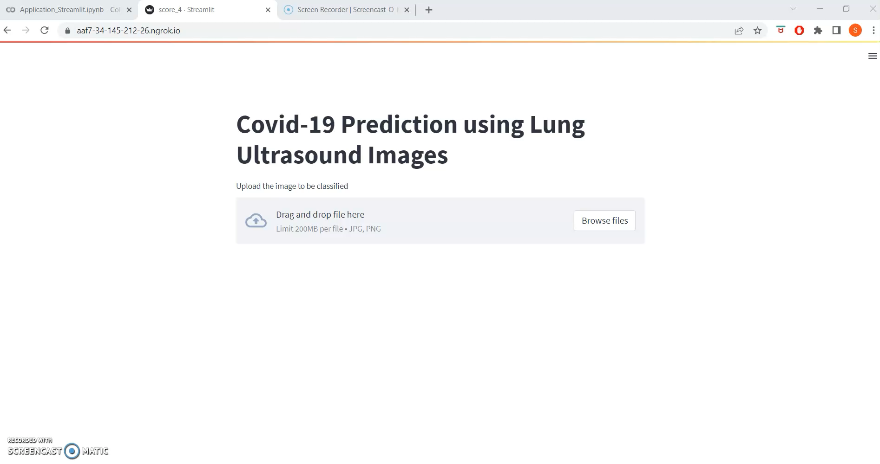

Slide 19
Web Application Demo

